Slide 1
Social science and Policy
Working with DECC
Presentation to the BSA Climate Change Study Group, 26 Oct 2012

Slide 2
Agenda
Welcome
Inside-out: presentation on DECC, policy making and social research in government
Refreshments, mingling and chatting
Outside-in: experiences of working with DECC

Slide 3
What I’ll cover
About DECC
“Policy making”
Social Research in Government
My job
Working with and for DECC social research
  Case examples

Slide 4
DECC’s policy portfolio
Department of Energy & Climate Change
MOIRA WALLACE
Permanent Secretary
International Climate Change and Energy Efficiency
Phil Wynn Owen
Energy Markets & Infrastructure
Simon Virley
EMI Strategy & Prog Office
Patrick Erwin
Energy Efficiency Deployment Office (EEDO)
David Purdy (t/p)
Customer Insight & Engagement
Liz Owen
Energy Efficiency Delivery Office
Trevor Hutchings
Economics & Analysis
Sam Thomas (t/p)
Energy Markets & Networks
Jonathan Brearley
Int’l, EU & Energy Security
Edmund Hosker
Energy Development
Jim Campbell
Commercial
Hugo Robson
OCCS
Adam Dawson
ORED
Hugh McNeal
OND
Mark Higson
Heat & Industry
Stephen Martin
Green Deal
Tracy Vegro
Smart Meters Programme Delivery
Rob Turner
Fuel Poverty & Smart Meters
Daron Walker
Int’l Climate Change
Pete Betts
Chief Scientific Advisor
David MacKay
Chief Operating Officer
Wendy Barnes
Strategy
Ravi Gurumurthy (reporting to Perm Sec)
Communication
Chief Economist
Stephen Fries (reporting to Perm Sec)
Science & Innovation
Paul Hollinshead
Performance & Planning
Scott McPherson
Finance & Information Services
Vanessa Howlison
HR
Alison Rumsey
DECC Legal
Scott Milligan
Nuclear Decommiss-ioning & Security
Vanessa Nicholls
Shex NDA Governance
Mark Russell

Slide 5
In this Parliament, DECC’s work is arranged around 35 programmes, with 10 of these as top priorities
Business Plan objectives:
(Level 0)
Drive ambitious action on climate change at home and abroad
Delivering secure energy on the way to a low carbon energy future
Save energy with the Green Deal and [help to] support vulnerable customers
Manage our energy legacy responsibly and cost effectively
Group level management:
(Level 1)
Operations Group
International Climate Change and Energy Efficiency Group
Energy Markets & Infrastructure Group
Strategy and Evidence Group
NDA Programme
NDA Programme
Green Deal
Fuel Poverty
Electricity Market Reform
Future Electricity Networks
Renewables
Economics, Statistics
Strategy
Programmes & Work areas: (Level 2 – each with a Programme Board and delivery plan or strategy)
= 35 Programmes, including BAU
Civil Nuclear Security
HR
Heat
Smart Meters
EU Policy
Int’l Energy
Carbon Capture & Storage
Comms
Non Proliferation
Finance
Industrial Energy Efficiency
Int’l Climate Change
Energy Security
Energy Resilience
Climate & Energy Science & Analysis
Legal
Planning & Performance
New Nuclear
Plutonium Mgmt
Geological Disposal Facility
Energy Innovation
& Engineering
Infrastructure & Information Services
Private Office
Energy Planning
UKCS
Oil & Gas
Coal Liabilities
Carbon Budgets & 2050
Pathways

Slide 6
The Policy Delivery Cycle
“Which Stage am I at?”
Note: policy making is rarely as straight forward as a simple stage by stage approach. Policy stages may need to be iterated or repeated if it is evident that the policy isn’t right. For definitive guidance, see:
Cabinet Office Policy Hub
DEFRA Policy Making Cycle
Ministers/Departmental Board: assesses policy need and makes resources available to scope it
Evidence Panel: considers evidence required to support policy decisions & agrees strategic analysis
4. Operate, evaluate & adapt
1. Understand situation and desired outcomes
Evaluation Board: considers formal evaluations of policies
Analytical projects
Programme Board and/or Approvals Committee: agrees strategic business case
Key Stakeholders: to be involved throughout policy cycle
Ministers: agree key objectives and scope of policy
Programme Board: oversees implementation & agrees ‘go live’
Parliament: passes legislation (primary or secondary) required
3. Prepare for delivery
2. Develop and appraise options
Chief Economist/CSA: signs off impact assessments for consultations & policy statements
Programme Board and/or Approvals Committee: agrees full business case and relevant procurement decisions
Interdepartmental Analysts Group (IAG): reviews impact assessments
Cabinet sub-Committees include:
Economic Affairs Committee
Reducing Regulation sub-Committee
European Affairs Committee
National Security Council
Regulatory Policy Committee [independent]
Ministers & Cabinet sub-Committees*: agree consultation documents & policy statements post consultation
Programme Board and/or Approvals Committee: agrees outline business case

Slide 7
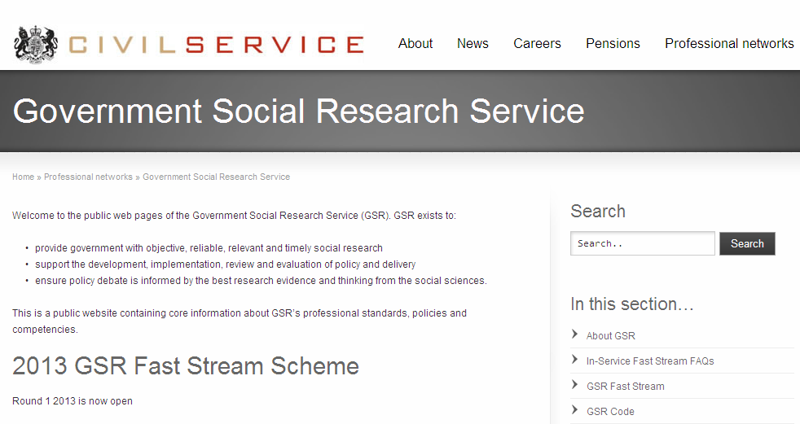
GSR in government
www.civilservice.gov.uk/networks/gsr

Slide 8
What do we do?
Identifying social research in policy questions
Shaping and designing research studies
Commissioning research with external providers
Reviewing research and assessing its quality and relevance
Summarising and interpreting research for policy officials and ministers
Working with internal economists, statisticians, engineers, operational researchers
Working with external research community

Slide 9
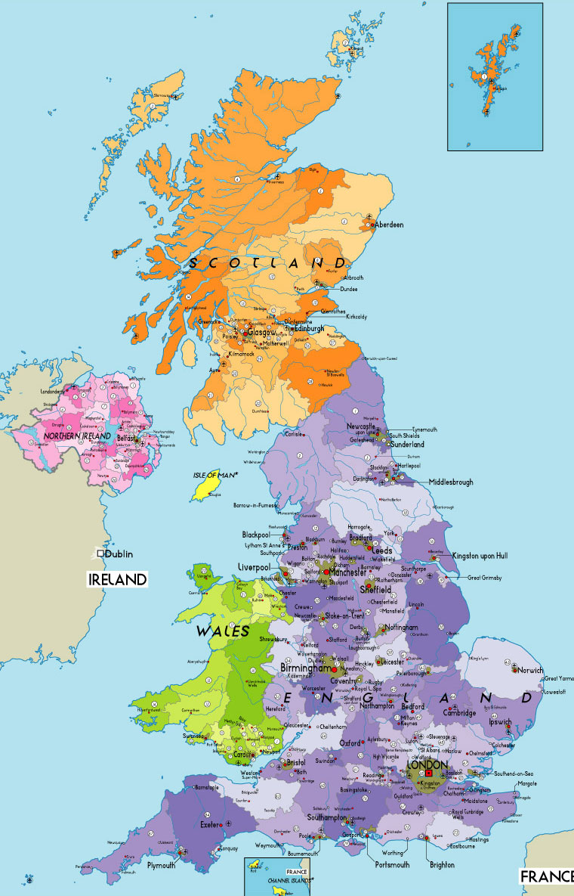

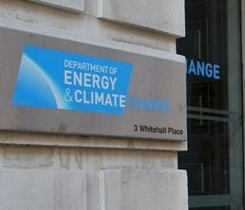
My job
adam.cooper@decc.gsi.gov.uk
0300 068 5268

